Slide 1
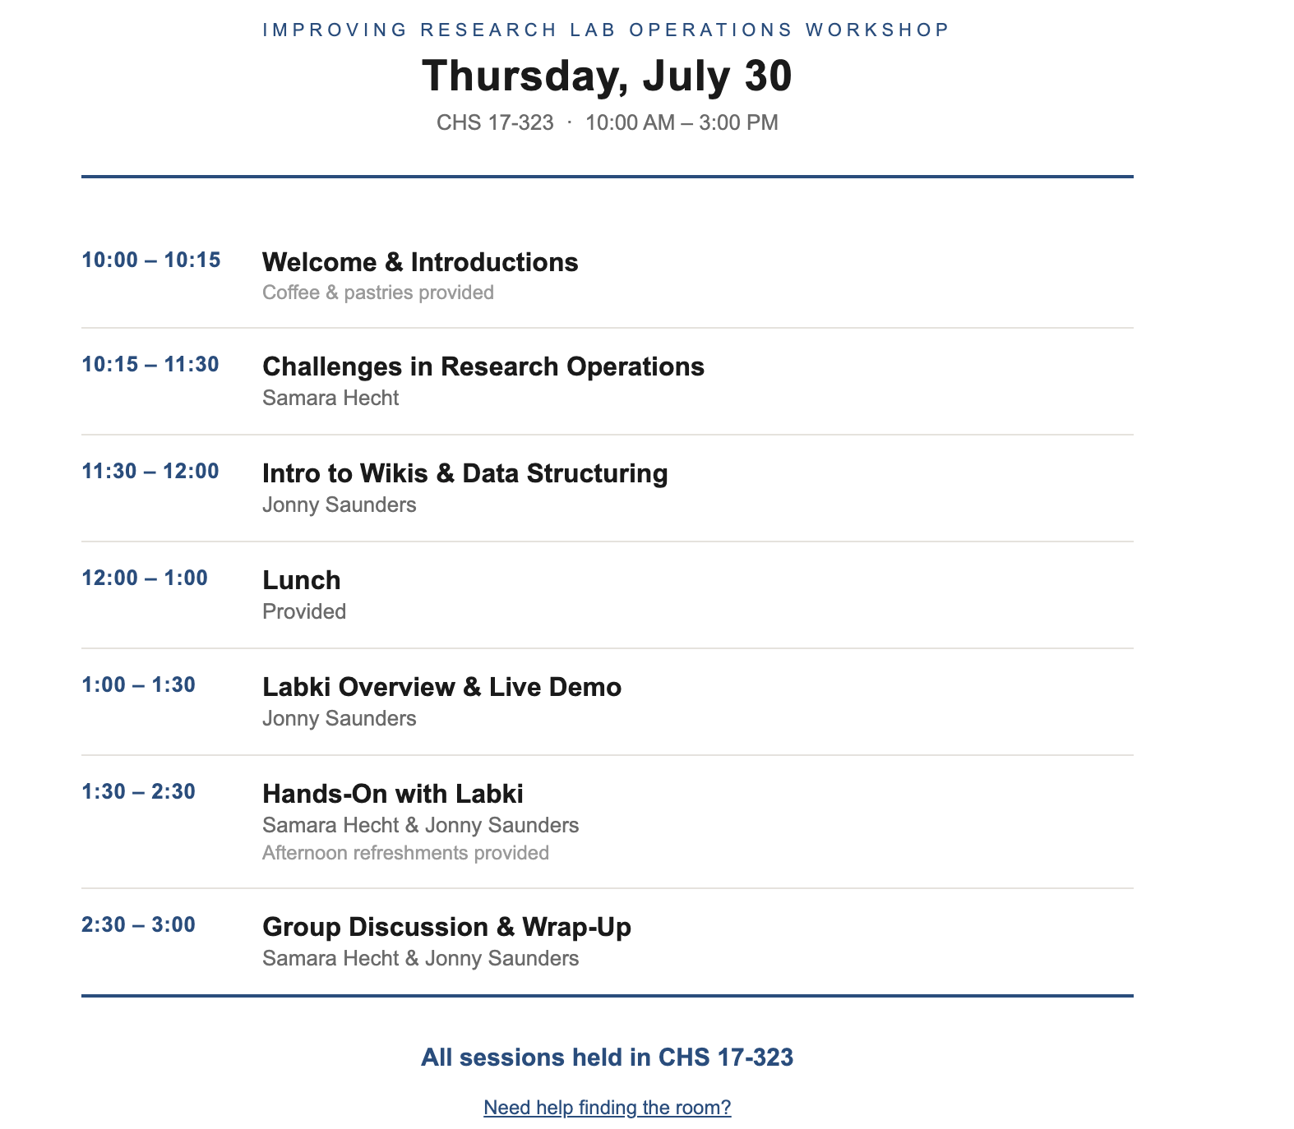

Slide 2
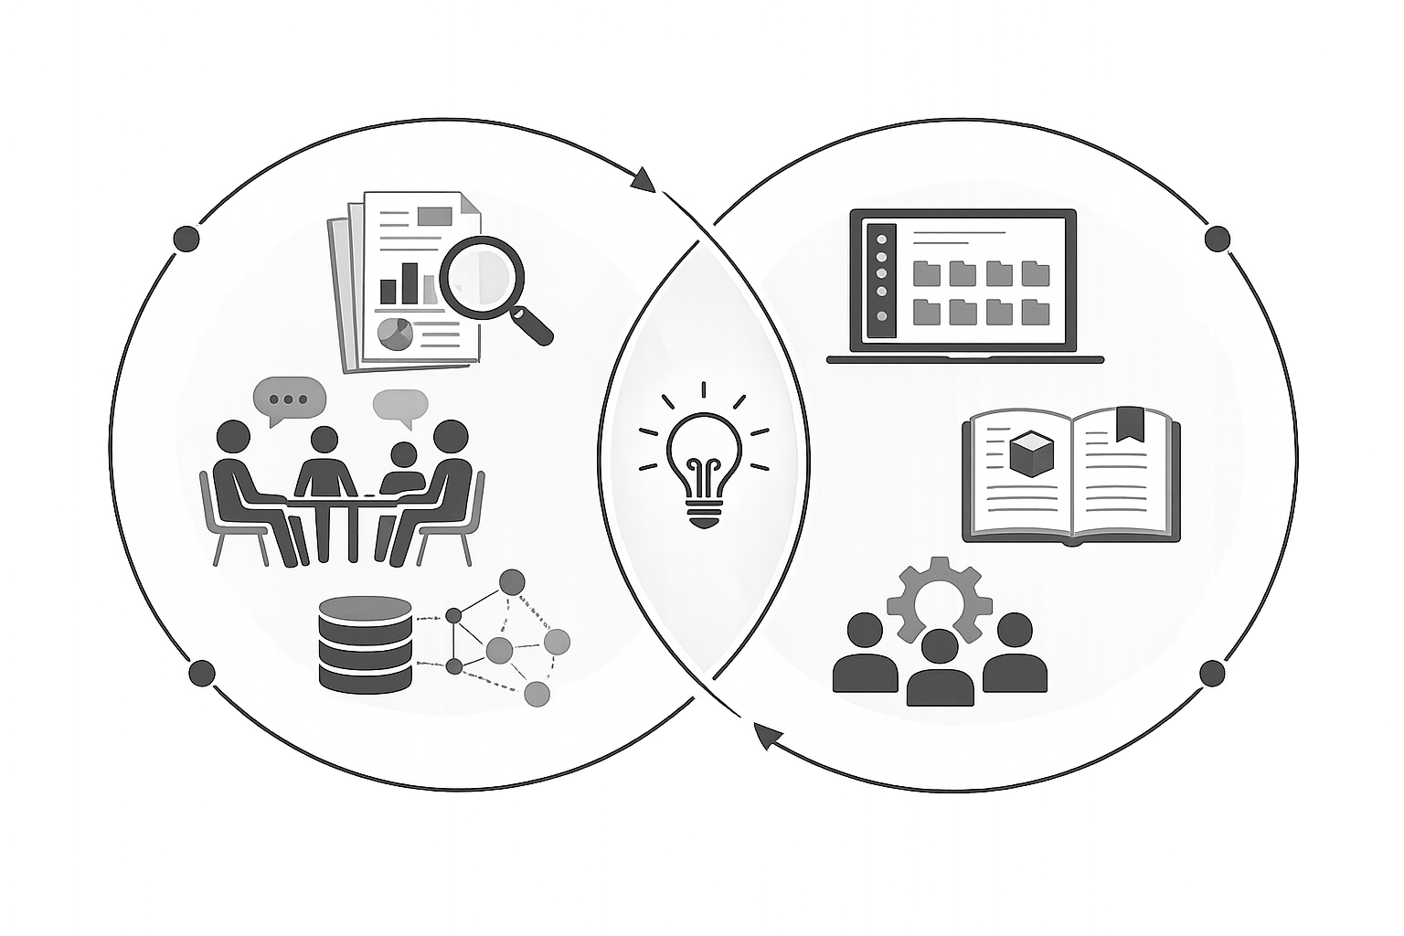
LABKI WORKSHOP
Operational Challenges in Academic Research

Slide 3
What we'll cover
01
What are lab operations and why do they matter
3 discussions
Reproducibility, turnover, and the protocol nobody wrote down.
02
The lab is an organization
2 discussions
Decades of research on organizations. Who does the work that never shows up on a CV.
03
Designing something people will actually use
2 discussions
Why shared tools fail, and the one thing that makes them stick.

Slide 4
What are lab operations and why do they matter
Reproducibility, turnover, and the protocol nobody wrote down.

Slide 5



What are “Operational Practices”?
Knowledge
People
Resources
How protocols, data, and know-how get written down and passed on (instead of just living in someone's head).
How new members get trained, how responsibilities get handed off, what happens when someone leaves.
How equipment, budgets, inventory, and schedules actually get tracked and managed day to day.
In academic research environments, "admin" is often treated like a dirty word. But research operations determine how efficiently, reproducibly, and collaboratively science gets done.

Slide 6
DISCUSSION
What counts as “real science”?
1
What kinds of work in your lab are considered "real science," and what kinds of work are viewed as "just admin"?
2
Which research problems are actually caused by systems rather than science?

Slide 7
Why Lab Operations Matter
Reproducibility
Turnover
Documentation
If a protocol only lives in someone's head, no one (including you!) can repeat the result later.
Lab managers and trainees turn over every year or two. Each departure resets what the lab knows.
When protocols and policies aren't well documented, science suffers.
….just to name a few reasons

Slide 8
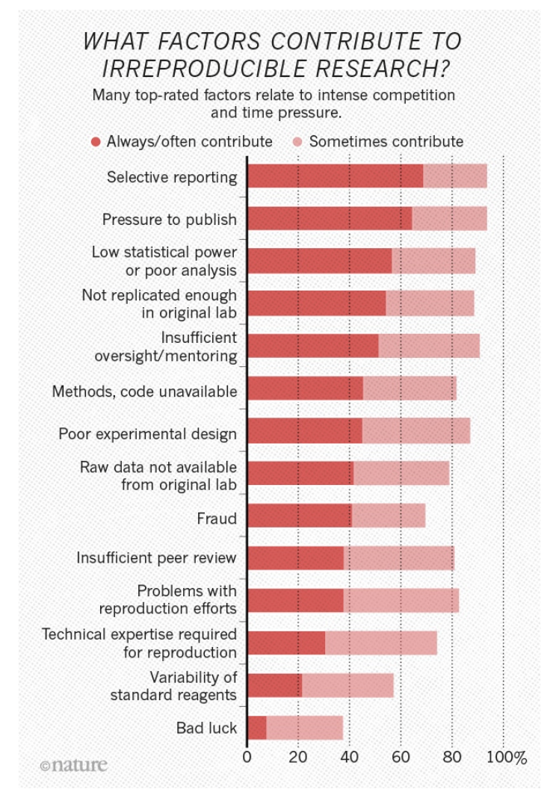
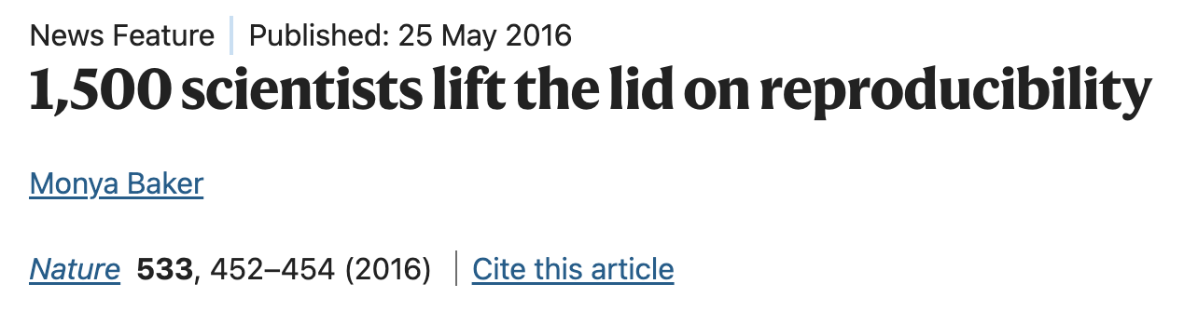
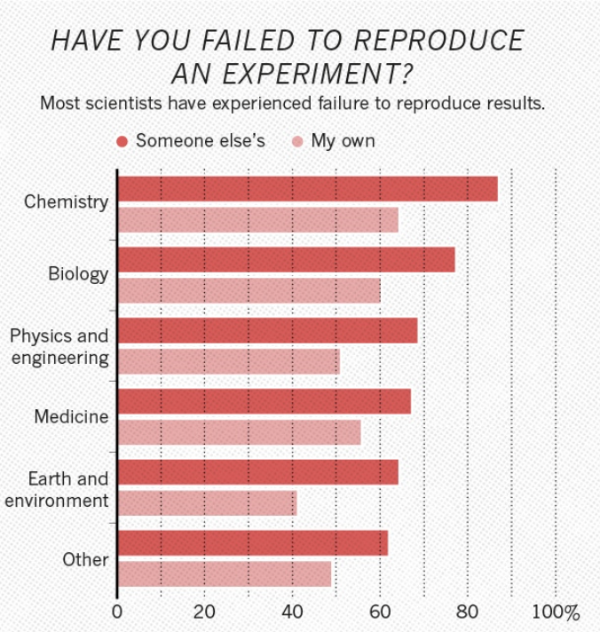
Reproducibility
Baker, M. (2016). Brief online survey emailed to Nature readers and promoted via affiliated websites/social media, yielding 1,576 self-selected respondents across disciplines (biology, chemistry, medicine, physics/engineering, earth/environment, other); data are self-reported attitudes and experiences, not independently verified reproducibility rates.
https://www.nature.com/articles/533452a

Slide 9
DISCUSSION
Reproducibility
1
Do you think the reproducibility crisis is primarily a scientific problem, a statistical problem, or a systems problem?
2
Have you ever tried to reproduce your own past experiment and struggled because the record-keeping wasn't detailed enough?
3
Are there tradeoffs between maximizing productivity and maximizing reproducibility?

Slide 10
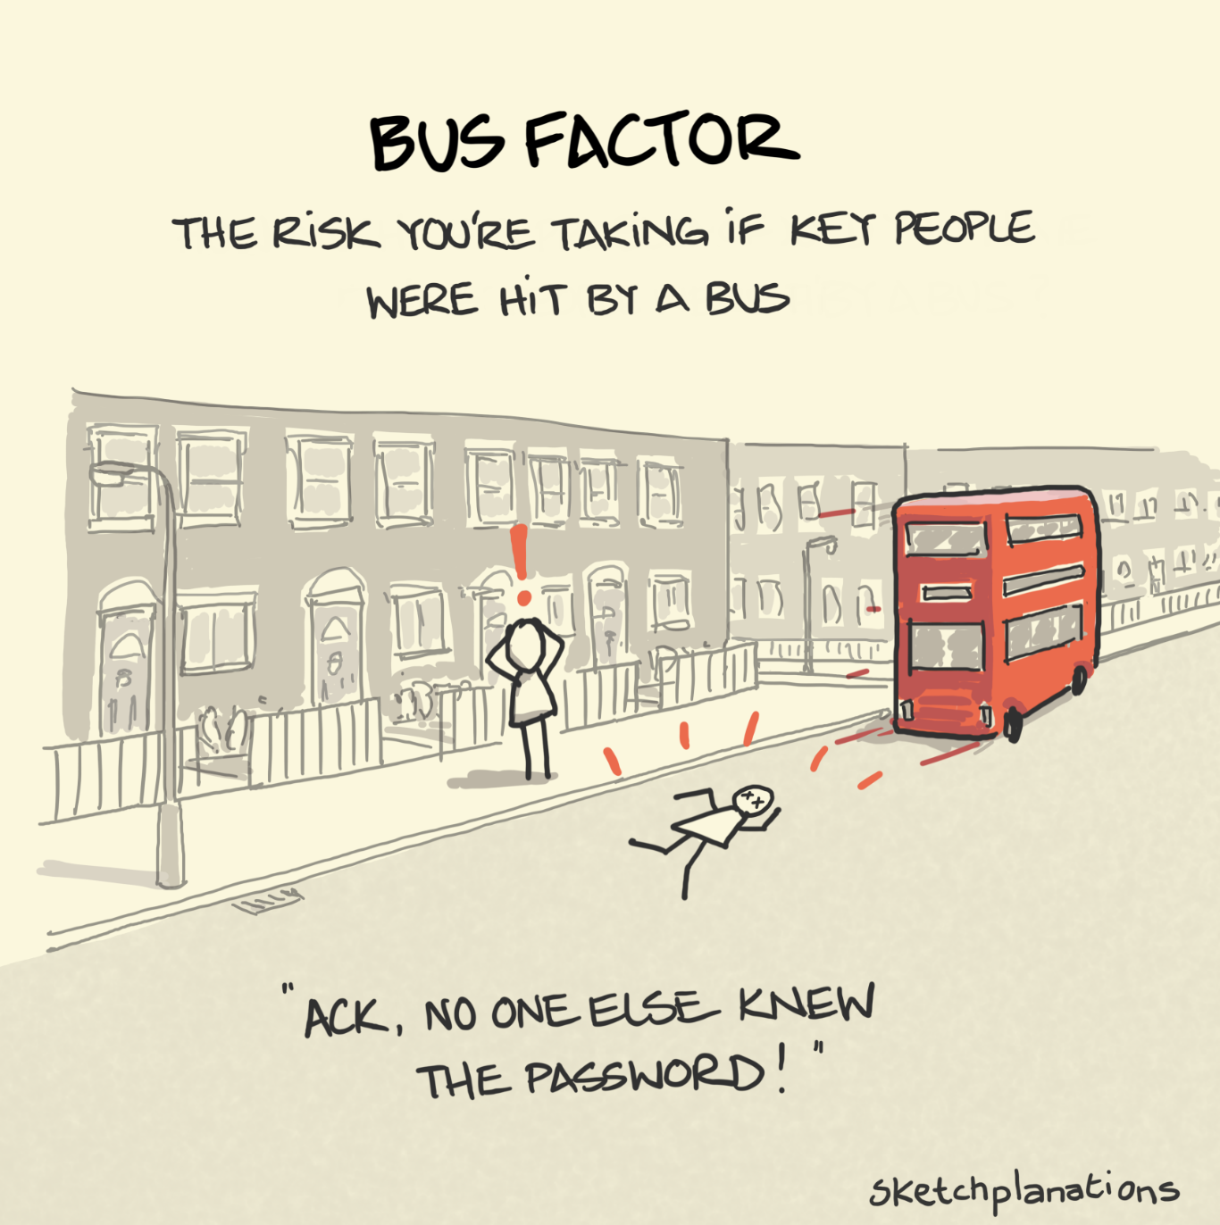
The risk resulting from information and capabilities not being shared among team members
Source
Avelino, Passos, Hora & Valente, 2016, ICPC · Massingham, 2018, Journal of Knowledge Management

Slide 11
DISCUSSION
Institutional Knowledge & Turnover
1
How much of your lab's knowledge is documented versus passed down informally?
2
What knowledge leaves your lab every time someone graduates or changes jobs?
3
What knowledge is worth documenting? What isn't?

Slide 12
Original protocol
Non-standardized / non-existent documentation practices
Researchers who study how a shared document splinters across a group call this protocol drift (a concept from Science and Technology Studies). This is so common and costs so much time.
Samara's version
Works, but was never written down
The published version
reviewer asked for a change
What the new trainee was taught
learned by watching, not reading
“Whatever works”
Star & Griesemer, 1989, Social Studies of Science
nobody remembers which is correct

Slide 13
DISCUSSION
Protocols & SOPs
1
Where do your protocols actually live right now (e.g. paper notebook, shared drive, someone's head) and why there?
2
How do you know if a protocol on the shared drive is the current version or an outdated one?
3
What's an example of a protocol that drifted, or got modified informally, without anyone updating the record?
4
How do you handle versioning when different people run slightly different variants of the “same” experiment?

Slide 14
There persists a strongly held belief amongst academics that… the creative process of research cannot be managed…. and research is best left to the individual scientist who knows best what are the most interesting research questions and how they should be pursued. But research has become too important…and too expensive, to be left entirely to the whims of individual academics.
- Nguyen & Meek, 2015, Journal of Research Administration
The lab is an organization.

Slide 15
What's on the CV
People study this for a living!
papers · grants · talks
Organizational researchers call it invisible work: the labor that keeps a place running but never shows up in the record: the reminding, the reordering, the reason a protocol looks the way it does.
(And of course the people who take on this work are often women. A large study of faculty found women take on significantly more of this internal, keep-things-running service than men, even controlling for rank and field.)
– training the new student
– ordering before you run out
– remembering why the protocol changed
– fixing the incubator, quietly
– answering the same question five times
What keeps the lab running
Star & Strauss, 1999 · Guarino & Borden, 2017, Research in Higher Education
NSF funds a program called Science of Organizations and is currently funding a project mapping the organizational models of academic labs.

Slide 16
Organizational and operational choices are linked to research capacity and outcomes
Nguyen & Meek, 2015 · “Key Considerations in Organizing and Structuring University Research” · The Journal of Research Administration 46(1), 41–62 · applying Mintzberg’s (1979) theory of organizational design
FIVE MORE VISIBLE
FIVE LESS VISIBLE
produce positions and units. Things that they show up on an org chart
produce policy, capability, and culture
1
Create research positions
1
Develop rules for research integrity
2
Create research management positions
2
Develop procedures for the project lifecycle
3
Decide the primary units for research delivery
3
Develop a mechanism for evaluating quality
4
Create a research office
4
Training people for the role
5
Create research oversight committees
5
Who actually decides what
The invisible half is harder.
Productivity / success in research is hard to measure
Rules, procedures and judgment are more complex and more contested than any org chart. And yet get far less attention.
Publication counts, peer review and bibliometrics are all proxies, each flawed in a different direction.
The same authors warn against the opposite failure: an over-managed lab kills the thing it is trying to protect. The aim is a shared floor everybody can work from, not central control.
Notes:
Nguyen, T. L. H., & Meek, V. L. (2015). Key considerations in organizing and structuring university research. The Journal of Research Administration, 46(1), 41-62. Applies Mintzberg (1979) four generic design parameters — design of positions (job specialization, behaviour formalization, training/indoctrination), design of superstructure, design of lateral linkages, design of a decision-making system — decomposed into ten tasks.
Why it matters for LabKI: this is the institution-level analogue of the lab-level question. It independently argues that organizational and operational choices are linked to research capacity and outcomes, and Table 2 in the paper is a clean citable framework for a literature review.
Companion paper worth citing alongside it: Nguyen & Meek (2016), 'Key Problems in Organizing and Structuring University Research in Vietnam: The Lack of an Effective Research Behaviour Formalization System,' Minerva. That one is specifically about the absence of operational standardization — closest published analogue to the operational-standardization hypothesis.

Slide 17
Who is responsible for making a lab run well? The PI? Lab manager? Trainees? Everyone?
Blurring roles across the hierarchy made basic-research labs more productive.
DEVIATION FROM THE STEREOTYPE
HOW COMMON
IN BASIC RESEARCH
Members help plan
choosing subject, hypothesis, design
32%
▲ helps
Lab head stays at the bench
running experiments, analyzing data
49%
▲ helps
Members do the writing
drafting the paper
53%
▼ hurts
▲ helps
Shibayama, Baba & Walsh, 2015 · Research Policy 44, 610–622 · 396 Japanese bioscience lab heads surveyed (2010), 305 labs analyzed against Web of Science output, 30 interviews

Slide 18
DISCUSSION
Day-to-Day Operations
1
What's the most time-consuming “non-research” task you deal with regularly (e.g. ordering, scheduling equipment, compliance paperwork)?
2
How does your lab track shared equipment bookings, and has double-booking or downtime ever caused real problems?
3
How do you track reagent and supply inventory, and how often does something run out unexpectedly?
4
What does your lab's version of “tribal knowledge” look like — the stuff everyone just knows but isn't written anywhere?

Slide 19
Designing something people will actually use

Slide 20
Why shared tools often fail
DOES THE WORK
GETS THE BENEFIT
One of the oldest, most-repeated findings in workplace software research: collaborative tools fail to catch on when the person doing the work of using them isn't the person who benefits from it.
If the postdoc has to log every reagent order and the PI is the one who gets the tidy spending report, don't expect the log to stay current.
Enters every order
into the tracker
Reads the tidy
spending report
the gap where adoption dies
Postdoc: logs reagents
Grad student: books equipment
Undergrad: fills out the form
Grudin, 1994, Communications of the ACM

Slide 21
Two fields have spent decades studying how people use tools at work
STS
Science and Technology Studies
CSCW
Computer-Supported Cooperative Work
Looks at how science really gets done. The equipment, the record-keeping, who defers to whom. Not the version that ends up in the methods section. Most of what holds a lab together was never designed. It accumulated.
Started in the 1980s, when it became obvious that software built for groups kept failing. Forty years of asking why. If you want to know in advance why your lab wiki died, it's in there.
Hand people a finished tool and they work around it. Build it with them and they use it.
Participatory design: Bødker, Ehn & Kyng, 1987–1991. On invisible work: Star, 1999. On why group software fails: Grudin, 1994.
Notes:
Job of this slide: introduce STS and CSCW from cold, in about two minutes, and use them to explain why the session is half discussion.
If you want to say more out loud: STS treats science as something people physically do, with instruments and paperwork and pecking orders, rather than as an abstract method. CSCW got started because software kept being designed for one person and then handed to a group, where it fell over.
The convergence is the actual content. Grudin's 1994 paper listed why groupware fails, and his first item was the mismatch between who does the work of feeding a tool and who gets the benefit from it. The Scandinavian participatory design projects got to the same answer from the labour side, by having workers co-design the systems instead of receiving them.
Land the last line and move on. It tells the room their discussion is the deliverable, not politeness.

Slide 22
DISCUSSION
Tools Currently in Use
1
What tools does your lab currently cobble together for lab management — Notion, spreadsheets, Slack, paper — and what's missing?
2
What's a tool you tried adopting that failed, and why didn't it stick?
3
If a tool required extra data entry with no immediate payoff, would your lab actually use it consistently?

Slide 23
Two fields have spent decades studying how people use tools at work
STS
Science and Technology Studies
CSCW
Computer-Supported Cooperative Work
Looks at how science really gets done. The equipment, the record-keeping, who defers to whom. Not the version that ends up in the methods section. Most of what holds a lab together was never designed. It accumulated.
Started in the 1980s, when it became obvious that software built for groups kept failing. Forty years of asking why. If you want to know in advance why your lab wiki died, it's in there.
Hand people a finished tool and they work around it. Build it with them and they use it.
That idea has a name, participatory design, and it goes back to Scandinavian factories and offices in the 1970s where the workers helped design the software.
Participatory design: Bødker, Ehn & Kyng, 1987–1991. On invisible work: Star, 1999. On why group software fails: Grudin, 1994.
Notes:
Job of this slide: introduce STS and CSCW from cold, in about two minutes, and use them to explain why the session is half discussion.
If you want to say more out loud: STS treats science as something people physically do, with instruments and paperwork and pecking orders, rather than as an abstract method. CSCW got started because software kept being designed for one person and then handed to a group, where it fell over.
The convergence is the actual content. Grudin's 1994 paper listed why groupware fails, and his first item was the mismatch between who does the work of feeding a tool and who gets the benefit from it. The Scandinavian participatory design projects got to the same answer from the labour side, by having workers co-design the systems instead of receiving them.
Land the last line and move on. It tells the room their discussion is the deliverable, not politeness.

Slide 24
Build it with people, not for them
BUILT FOR THE LAB
The infrastructure everyone relies on is mostly invisible …which means nobody designed it on purpose, and nobody can tell you how it works.
The oldest lesson in workplace system design is that the people who'll use a system have to help build it.
builders
the lab
handed over finished
BUILT WITH THE LAB
builders
the lab
shaped by the people using it
Star, 1999 · Bødker, Ehn & Kyng, 1987–91 · Taylor, 2006, in Nguyen & Meek, 2015

Slide 25
More structure isn't the goal
When researchers compared high- and low-performing academic departments, the high performers weren't the tightly managed ones.
Structure that turns into control reliably backfires — the same review warns that an over-managed research organization ends up killing the goose that lays the golden eggs.
LOWER-PERFORMING
HIGHER-PERFORMING
More formality
Tighter control
Steeper hierarchy
More autonomy
More egalitarian
Less emphasis on formality
“A good research management strategy should not produce central control, or even supervision, but will combine freedom within which academics make their own decisions, and a system to identify any emerging problems at an early stage.”
— Kirkland, 2008
Marabaeva, Shilkina & Myagkova, 2025
Edgar & Geare, 2013, Studies in Higher Education · Kirkland, 2008 · Nguyen & Meek, 2015

Slide 26
DISCUSSION
Tool Design & Adoption
1
What would make you actually trust a new system enough to migrate years of lab history into it?
2
How much setup or maintenance overhead is acceptable before a tool becomes “one more thing to manage” instead of a solution?
3
Should operational tooling be lab-specific or standardized across a department — what would you gain or lose either way?
4
What would make a new lab member's first week measurably easier, concretely?
5
If you could wave a wand and have one operational headache disappear permanently, what would it be?

Slide 27
Rethinking Research Operations
A lab is an organization. Organizations have been studied for decades. We don't have to guess..
There's no one right structure. What works depends on the science, the size, and who you're trying to train.
Reproducibility is downstream of documentation. Not of how careful any one person happens to be.
Tools fail on people, not features. Tools are adopted when they create value for their intended users.

Slide 28
Sources
LAB ORGANIZATION & TASK ALLOCATION
RESEARCH MANAGEMENT & STRUCTURE
Shibayama, Baba & Walsh, 2015, Research Policy 44, 610–622
Colyvas, Organizational Models of Scientific Inquiry,
NSF award 2420245, Science of Organizations, 2024–2027
Shimizu, Nirei & Maruyama, 2012
Knorr-Cetina, Epistemic Cultures, 1999
Latour & Woolgar, Laboratory Life, 1979/1986
Nguyen & Meek, 2015, Journal of Research Administration 46(1)
Mintzberg, The Structuring of Organizations, 1979
Edgar & Geare, 2013, Studies in Higher Education
Kirkland, 2008, Technology Analysis & Strategic Management
Pettigrew, Lee, Meek & Barros, 2013, OECD
Connell, University Research Management, 2004, OECD
Marabaeva, Shilkina & Myagkova, 2025, in University 4.0 and
Educational Technology for Sustainable Development
KNOWLEDGE LOSS & TURNOVER
Avelino, Passos, Hora & Valente, 2016, ICPC
Massingham, 2018, Journal of Knowledge Management
REPRODUCIBILITY & DATA
Open Science Collaboration, 2015, Science
Baker, 2016, Nature 533, 452–454
Ioannidis, 2005, PLoS Medicine
Borgman, Big Data, Little Data, No Data, 2015
COORDINATION & COLLABORATIVE TOOLS
Olson & Olson, 2000, Human–Computer Interaction
Malone & Crowston, 1994, ACM Computing Surveys
Grudin, 1994, Communications of the ACM
Schmidt & Bannon, 1992
INVISIBLE WORK & ACADEMIC LABOR
Star & Strauss, 1999
Star, 1999, American Behavioral Scientist
Guarino & Borden, 2017, Research in Higher Education
Broadbent, Troup & Strachan, 2013
CAREERS & CLIMATE
Evans, Bira, Gastelum, Weiss & Vanderford, 2018, Nature Biotechnology
Woolston, Nature Postdoc Survey, 2023
CO-DESIGN
Bødker, Ehn, Kammersgaard, Kyng & Sundblad, 1987
Ehn & Kyng, 1991

